Slide 1
Rocket Construction Project
By Cole Harmaty

Slide 2
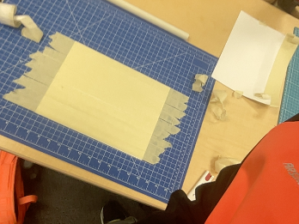
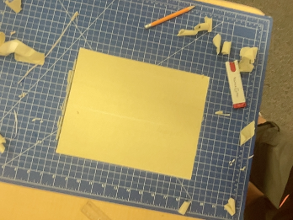
Step 1: Cutting Out The Body
I started off by grabbing a piece of paper and running tape from shortside to shortside. Eventually I covered the paper. Then, I cut off the excess tape and wrote my name on the paper.

Slide 3
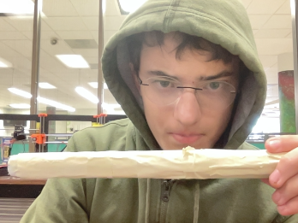
Step 2: Taping the Tube
I rolled the side with tape on it around the tube, starting from the long edge and rolling the paper around the tube until the two long edges met, and then I taped them together. I then started by running strips of tape parallel to the tube, so they didn’t overlap. I then began to wrap short strips of tape around the tube, so there was no overlap. I continued until I had wrapped 7 layers of tape total around the tube.

Slide 4
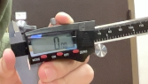
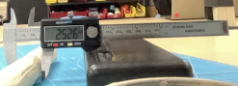
The Dial Cipher
Q. Why is calibrating measuring tools important?
Calibrating ones measurement tools is important because otherwise, you get inaccurate answers.
Q. Are there other places on the caliper to use for measurements?
The outer head(labeled 1) is helpful when measuring the inside diameter of something because you slide the jaws open until you can’t anymore. The rod, which comes out of (2) is useful for measuring the depth of something because you just slide the cipher open until the rod at the bottom of the caliper hits the bottom of whatever you are measuring, then you read the number on the screen.
1
2
Picture of Calibration

Slide 5
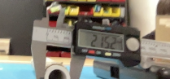
Step 3: Measuring
I slid the tube out of the tape, and used a dial cipher to measure the tape thing (25.26mm diameter), and the pvc tube(21.52mm diameter). There are other places on the dial cipher that I could use for measurements, such as the ruler part, and the smaller set of two prongs.
My measurements

Slide 6
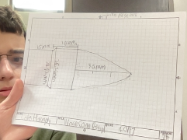
Step 4: Orthographic Drawing
Using my dimensions from my measuring, I made an orthographic drawing. One side of a square is equal to 2 mm. The drawing is not exactly to scale due to human limitations, but it doesn’t need to be, as it is a guide. This is my completed drawing. It works and the rest doesn’t matter.

Slide 7
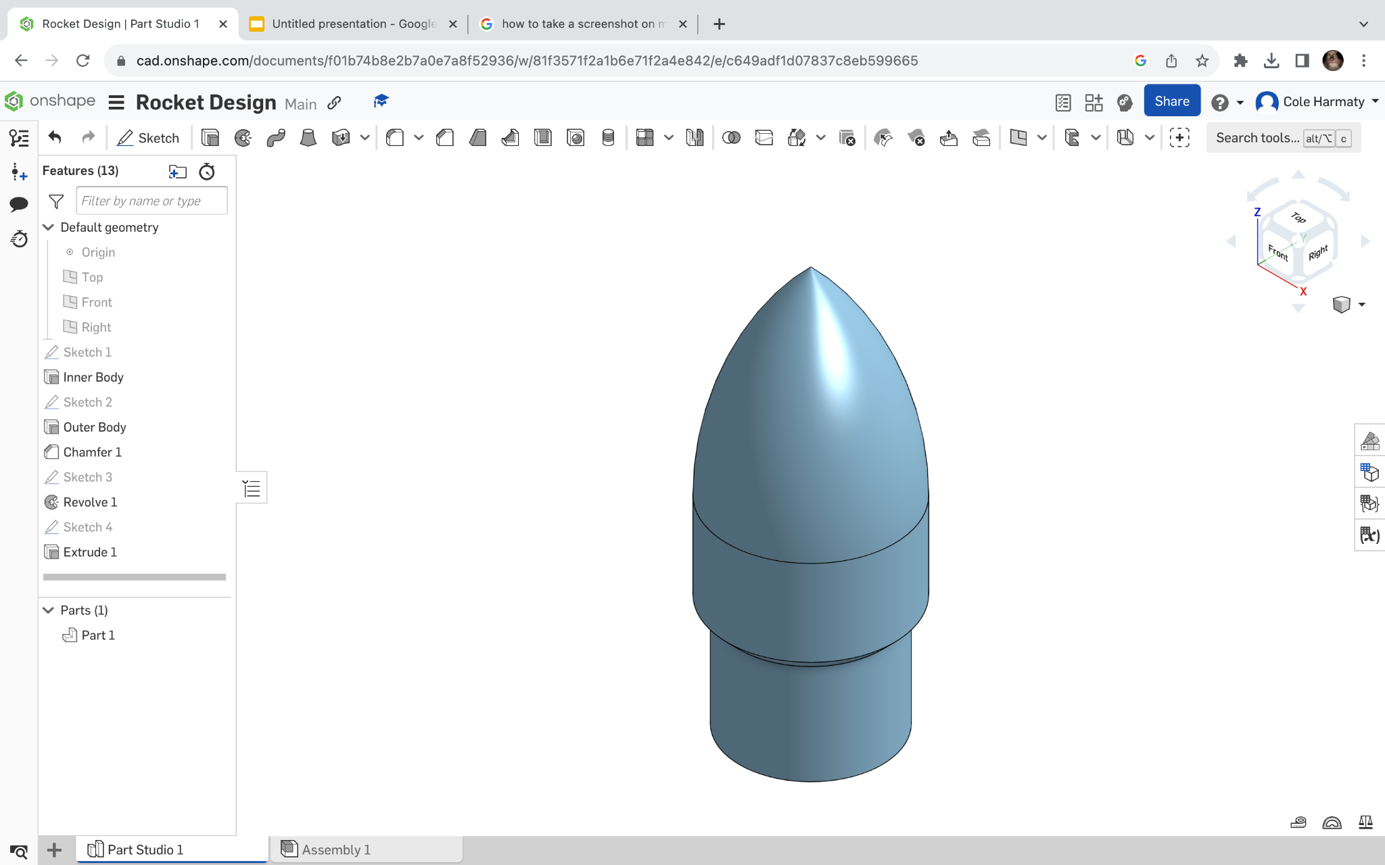
Step 5: Oneshape Design
I followed the youtube video to the letter, and I think you don’t want two pages of instructions, so link here. All I did was take the orthographic drawing for my nose cone, and made it into a CAD design. Then I made it into an STL file, and put it onto a USB stick. It got 3D printed. It weighs 8.36 grams
My completed nose cone.

Slide 8
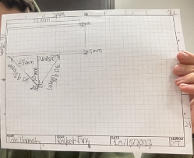
Step 6: Fin Design
I started off by researching the best fin shape. This was when I ran into problem # 1. It simply was that the optimal fin shape was an ellipse, and the assignment demanded the the fin have a flat base. However, time was tight, so a trapezoidal design seemed like the right balance between construction time and functionality, as it was easy to make in addition to be the only design that functioned as well as the eclipse. I choose to do three fins, as it seemed to provide reduced air resistance, and smaller fins, as big fins are not as necessary with the trapezoidal design. I did not have time to do the dimensions based on research, so I went with my gut. I made an orthographic drawing and set to work.

Slide 9
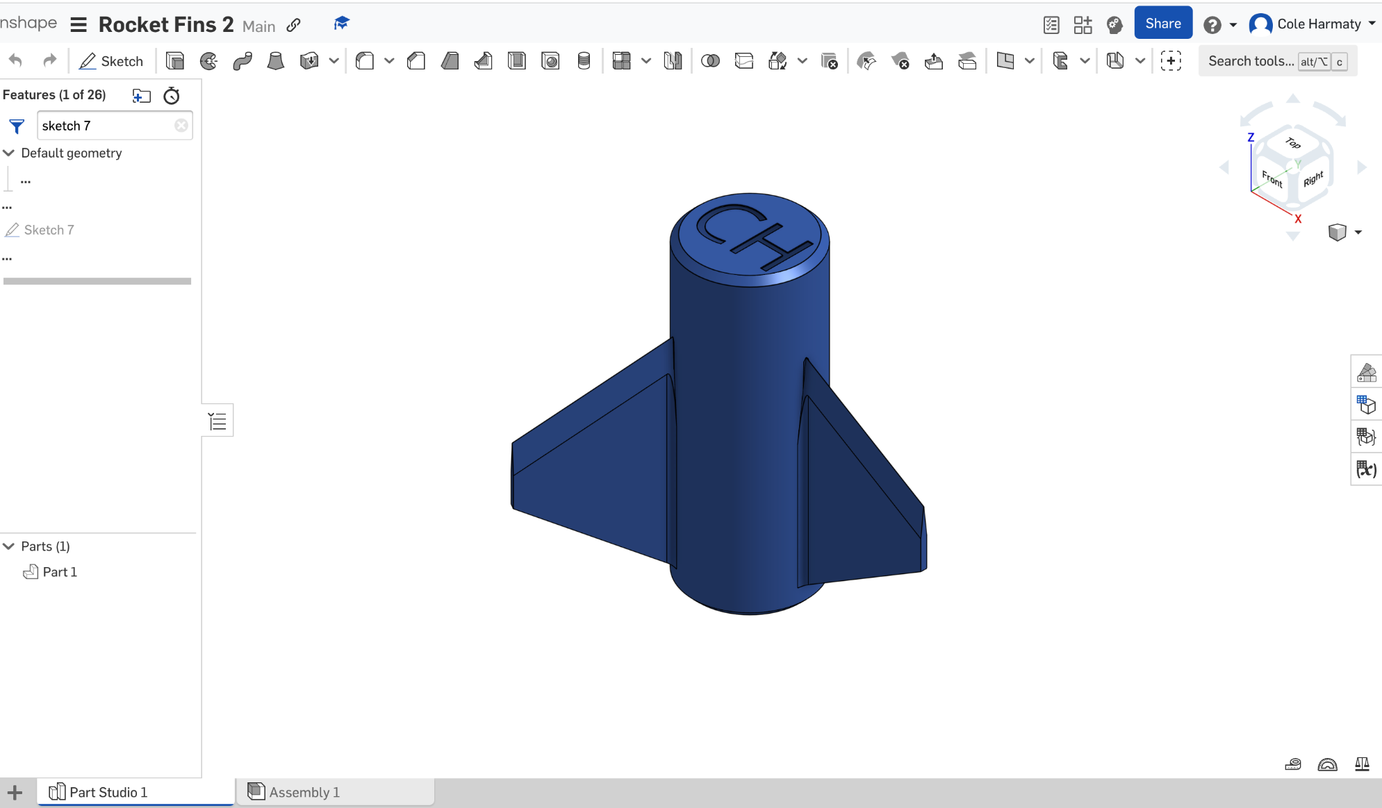
Step 7: Fin CAD Design
I converted my orthographic drawing into oneshape. I followed the instructions in this video to do so.
My completed rocket fins, weighing 16.38 grams

Slide 10
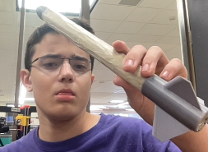
Step 8: Assembling The Rocket
Before I even started on the fins, my nose cone had printed. So, I asked the teacher to super glue it onto the body of my rocket. I also noticed a gap between the nose cone and the rocket body, so I used tape to cover it up. Then I did the stuff I covered in slides 6-8. Once I had my fins completed, I exported them as an STL file and then had them 3D printed. The first two times I tried, they didn’t make it onto the USB stick and therefore didn’t get printed. On my third try, I asked the teacher to walk me through it. Once my fins had printed, I used a tool to remove the cap with my initials in it from the rocket. Then I slid them onto the bottom of the rocket. My rocket weighs 64 grams.

Slide 11
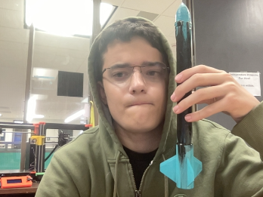
Step 9: Painting the Rocket
With my rocket assembled, it was time to paint it. The teacher had a bunch of cans of spray paint and told us we would each have one minute to paint our rocket. As I was waiting to be allowed to start, I considered a color scheme. I knew I only had time to paint with two colors. The only possible combinations that didn’t require me to use a color that wasn’t available in a tolerable shade, were black and either red, blue or cyan. As red and black was being used by just about everyone else, that was out. So, since I though the cyan would contrast better, I went with a cyan nose cone, fins, and thing that the fins attached to. The rest of the body was painted the deepest black available. After I had painted everything, I had to wait until the next class for the rocket to be done.

Slide 12
Mass of the rocket
8.63 grams
16.38 grams
39.26 grams
Total Mass: 64 grams

Slide 13
Step 10: 60 psi Launch
Today in Engineering class, I launched my rocket. I felt excited when it was my turn to launch. My rocket went decently high and really fast. When it hit the apex, it turned around and shot down nearly as fast as it went up, nose first. My rocket was a little bent up, and the top of the tube seemed to have peeled away from the nose cone. There is some dirt near the top and some of the paint is gone.
My rocket took 3.7 seconds to reach the apex of it’s flight. The total flight time was 7.25 seconds.

Slide 14
Step 11: 70 psi Launch
My first attempt at a 70 psi launch went horribly wrong. The nose cone went flying, and I had to super glue it back on and add tape to keep the rocket together. I repainted the body black to act as a sealant for the air pressure. The second launch went much better than the first one, with the rocket reaching the apex of it’s flight 3.6 seconds after launch, and landing 7.1 seconds after launch. It went up and down smoothly, and landed with its nose in the ground. It went straight up and down in a picture perfect parabola.

Slide 15
Step 12: 80 psi Launch
My eighty psi launch went well, however, the tube cracked upon hitting the ground. The rocket reached the apex of it’s flight 3.3 seconds after launch, and landed 7.3 seconds after launch. It went up while wobbling horizontally a lot. It went down smoothly nose first. The rocket was stuck a few inches deep into the ground.

Slide 16
Step 13: Compare and contrast(First Glance)
First, I used prusacslicer to get the mass of my rocket parts. My rocket weighs 64 grams total, with a nose cone mass of 8.36 grams, a fins mass of 16.38 grams, and a body mass of 39.26 grams. At 60 psi the it takes 3.7 seconds to reach the apex of the rockets launch, and 7.25 seconds for the entire flight. My data looks most similar to Riley Gauls, as the launch times for the 6o psi launch look very similar. My rocket looks most like Max’s Sulches, as the fins look very similar to his fins, the only real difference is the bulges on the end of his fins aren’t present on my fins. Dylans fins were very different from mine, as they had almost no similarities outside of the number fins and the reason for making stuff.

Slide 17
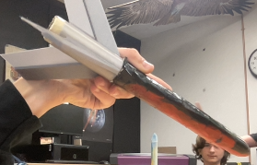
My Rocket vs Dylans
My Rocket Dylans
The fins on his are much bigger than on mine, and differently shaped.

Slide 18
Compared and contrast
The heat map revealed that my rocket fins were statistically most similar to Riley Gaul’s in performance, as I guessed without the computer. They were statistically most different from Araon Zeemio’s in performance. They were staticstically most different from Dylan’s in terms of physical data. They were physically most similar to Sean Finnagan’s in terms of physical data.

Slide 19
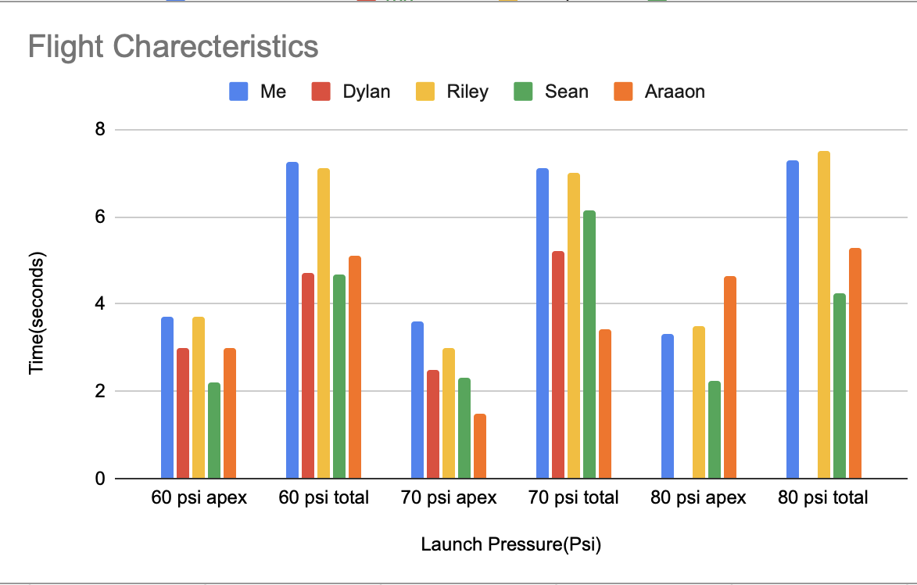
Flight Characteristics Chart

Slide 20
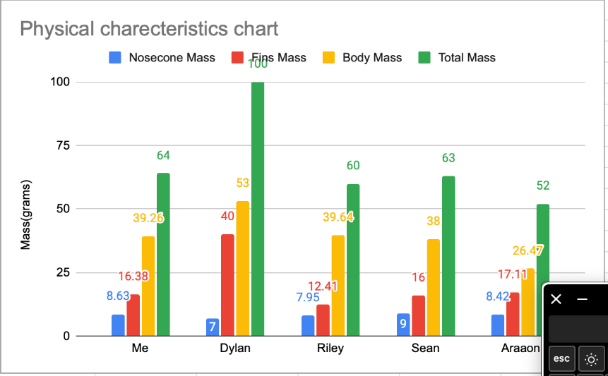
Physical Comparison Chart

Slide 21
My rocket statistics
Nose cone mass: 8.36 grams
Body Mass: 39.26 grams
Fin mass:16.38 grams
Total Mass: 64 grams
# of fins: 3
Descent: Nose Down
Optimal Psi: 60
60 psi Apex Time: 3.7 s
60 psi total time: 7.25 s
70 psi apex time: 3.6 s
70 psi total time: 7.1 s
80 psi apex time: 3.3 s
80 psi total time: 7.3 s

Slide 22
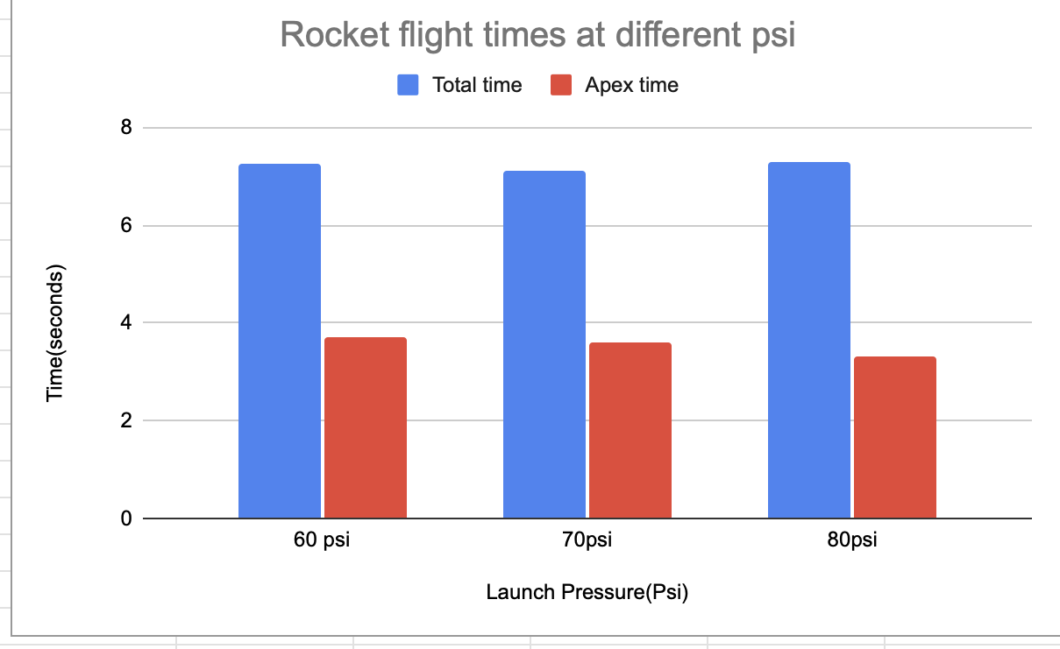
Visual Rocket Statistics

Slide 23
Why it probably happened?
I think the time to apex, and apparent height, decreased partially when I increased the pressure from 60 psi to 70 psi because I had to add more weight in the form of tape after my disastrous first attempt at 70 psi, making it not go as high. In addition to that, my rocket got more and more dinged up with each launch, and therefore less efficient.

Slide 24
The End

